Slide 1
Polyglot Persistence and NOSQL
Julian Breyer
4 DEC 2017

Slide 2
Agenda INSERT INTO TABLE Round_HOLE VALUE “SQUARE_PEG”
Day 1:
----------------------------------------------------------------------
1. Why Polyglot Persistence?
2. Relational Database: PostgreSQL
3. Key-Value Store: RIAK
4. Document Store: MongoDB
Day 2:
----------------------------------------------------------------------
5. Column Store: Apache Cassandra
6. Graph Database: Neo4J
7. Putting It All Together

Slide 3
What this is and isn’t
Technical overview
Mostly demos with a little theory so not for the faint of heart
We have two hours so definitely not a deep dive
Not an ops guide
Not an endorsement of any particular technology

Slide 4
So… what’s wrong with SQL
Nothing!
+ RDBMS are a proven, extremely powerful technology
+ SQL is (relatively) easy to learn
+ Schema enforcement helps with data quality
- Doesn’t easily scale to Internet scale (IoT, sensors, telemetry, …)
- Partitioning is possible but tedious
- Data comes in many shapes (structured, semi-structured, unstructured) – relations are not a good representation of all of them but the same is true for all of the other technologies.

Slide 5
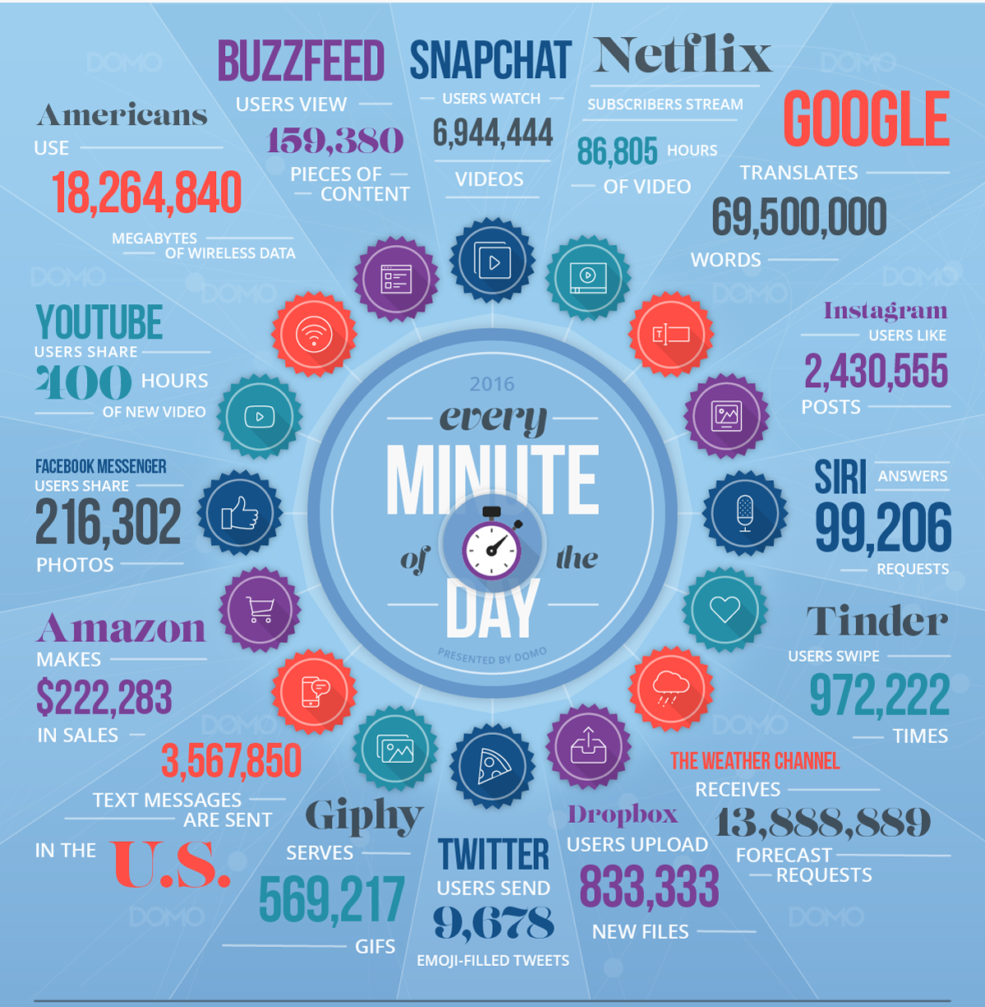

Slide 6

Enter Polyglot Persistence
“When all you have is a hammer, everything looks like a nail.”
Simple idea: use the database that best fits your data even if that means that a single application uses a number of databases.
Storage is cheap, developer patience is not!

Slide 7
Relational Databases
The grandfather of data persistence

Slide 8
Relational Databases
Based on relational calculus (“A Relational Model of Data for Large Shared Data Banks” E.F. Codd, IBM, 1970)
Uses the Structured Query Language (SQL) introduced by Boyce and Chamberlain (IBM, 1972)
Expresses what should be retrieved rather than how to retrieve it
Organization in relations (represented as tables) consisting of columns and rows (tuples).
Each row is identified by a key.
The structure of the table is dictated by a schema that all data must adhere to.

Slide 9
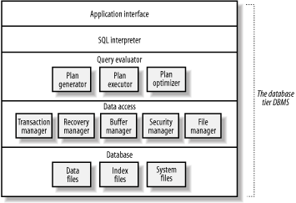
Components of an RDBMS

Slide 10
ACID
ACID – term coined by Jim Gray:
Atomicity
“All or nothing” – either all parts of a transaction are completed or none are.
Consistency
Changes to one part of the database must not lead to the inconsistency of another part (enforced through constraints)
Isolation
Concurrent reads/writes are serialized so as to not intermix
Durability
Once a transaction is committed, its effects must persist

Slide 11
SQL 101
Declarative vs Imperative (i.e. what vs how)
Three different types of statements:
Data Definition Language (DDL)
CREATE, DROP, ALTER
Data Manipulation Language (DML)
SELECT, INSERT, UPDATE, DELETE
Data Control Language (DCL)
GRANT, REVOKE, …

Slide 12
Example: Customer DB

Slide 13
What Are RDBMS good for?
Homogenous data adheres to a rigid schema
Allows for flexible queries
Very consistent and durable
ACID transactions

Slide 14
What Are RDBMS not good at?
Scaling! (usually only up, not out)
Flexible/unstructured data
Impedance mismatch (i.e. the complexities of translating object-oriented application data structures into the relational model through ORM)

Slide 15
Common Examples
Microsoft SQL Server
Oracle RDBMS
Postgres
MySQL

Slide 16
Key-Value Stores
The simplest data store you can find

Slide 17
KV Stores
Pretty much a hash-table persisted on disk
The data store does not care about the structure of the value and data is typically not queryable by anything in the value (only by the key)
Key
Value

Slide 18
Example: RIAK
RIAK doesn’t even implement a query language – just http endpoints
Creates buckets automatically
Add keys with PUT
Delete keys with DELETE
Resolve queries with GET

Slide 19
Demo - RIAK

Slide 20
When KV Stores are great
If you always know and query by the key
For quick, discrete lookups

Slide 21
Examples
RIAK
REDIS
(MEMCACHED)
Azure Table Storage

Slide 22
A better inventory and order system: Document stores

Slide 23
Properties of Document Stores
Typically schema free
Records in the same collection do not have to have the same structure
Columns can have multiple values (arrays) or have nested structures
Special case of the KV-store we’ll look at later
Part of the NoSQL family
Built for simplicity
Flexible query options
Documents are typically JSON but can be plain text value in a KV store (would require external de-serialization)

Slide 24
Example: MongoDB
SELECT = db.[collection].find()
INSERT = db.[collection].insertOne() / db.[collection].insertMany()
UPDATE = db.[collection].updateOne(<filter>, <update>, <options>) / db.[collection].updateMany() / db.[collection].replaceOne()
DELETE = db.[collection].deleteOne() / db.[collection].deleteMany()
OMG – the mongo shell is also a full JS interpreter!

Slide 25
Demo TIME

Slide 26
WHY IS THIS A THING?
Easy to learn / get started
Development first approach
Since there’s no schema, document structure can change any time
Richer queries than in a KV store
Documents are represented as objects so low impedance (no ORM necessary)

Slide 27
What are DocumentD Stores good at?
User profile and behavior data
Storage of application metadata / object persistence
Ingestion and presentation of data of variable structure (e.g. logs, product catalogs…)

Slide 28
What are DOCUMENTD Stores not good at?
OLAP
Complex Map/Reduce jobs
Distributed transactions
Highly relational data

Slide 29
Typical Examples
MongoDB
Amazon DynamoDB
Couchbase
CouchDB

Slide 30
Intermission: Brewer’s CAP Theorem

Slide 31
Brewer’s CAP Theorem
Brewer’s CAP Theorem states that there are three possible properties of data stores, only two of which any given data store can have:
Consistency (every read receives the most recently written data or an error)
Availability (Every query yields an answer but without any guarantee that it’s the most recent write)
Partition Tolerance (The overall system continues to work even when messages between instances are dropped or delayed)

Slide 32
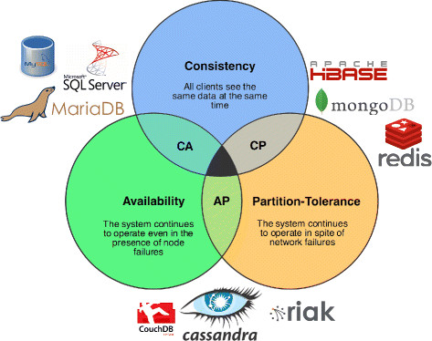

Slide 33
Brewer’s CAP Theorem
Most NoSQL data stores can’t guarantee ACID properties so BASE was developed as a basic set of guarantees:
Basically Available
Soft state
Eventually consistent (if an object has not changed, all instances will eventually yield the same answer to a query)

Slide 34
A DISTRIBUTED, partitioned row-store: Apache Cassandra
A distributed RDBMS without JOINs? Whoa!

